Slide 1

Buddy Scheme Mentor training
2022
Scarlett Catterall
Student Experience & Campaigns Coordinator
Notes:
-Before we begin: Introduce self, set expectations time-wise - 5min break in middle
-I’ll give everyone 5 mins or so to join
-Feel free to turn mics/cameras on to ask questions or use the chat at any time throughout the session
-If at any point you cant see the slides or I loose connection please shout and let me know
-REGISTER – important to capture everyone who's attending, as attending the training is one of our compulsory requirements
-We are going to put up a video of a session on QM plus and the slides, as you are doing training now but not meeting your mentees until Sep, you might need a bit of a refresher before then.

Slide 2

Thank you and welcome!
1) For signing up this year
2) For helping our community
3) For being such a great QM community
4) Buddy scheme is so great because of you
Notes:
First & foremost THANK YOU!
Thank you for signing up and turning up today.
Thank you for giving up some of your valuable time to help fellow students at what will be for some, one of the biggest, scariest, intimidating moments of their lives.
You are all key in making a massive difference, helping them build strong foundations for positive uni exp
You really are what makes our QM community so strong. Great to have you on-board despite corona virus throwing lots of uncertainty, stress and illness into the mix
All of the mentors that sign up are lovely and the success of the scheme is completely down to you.

Slide 3

What we will cover
- The Queen Mary Buddy Scheme
- Your role
- Communication & Empathy
5 min break
- Referral
- Scheme completion
- Inclusivity
- Meetings and events
- What next?
Notes:
What the QM Buddy Scheme is
What your role is as a mentor within the scheme
Look at some work on communication and empathy
BREAK
Referral and how you might refer people on
What it takes to complete the scheme
Talk a little bit about inclusivity and where you can find out more about that
This is a big part of the buddy scheme, so will cover what these events and meetings
What the next steps are in order to help you and the scheme

Slide 4


How to know what is going on
Follow us on Instagram: qmbuddyscheme
Look at the QMplus page: QM Buddy Scheme 2022/23
(you will be enrolled following training)
Send us an e-mail: buddyscheme@qmul.ac.uk

Slide 5

The Queen Mary Buddy Scheme
The Buddy Scheme helps incoming students settle into life at Queen Mary by matching them with current students who provide informal support by regularly meeting up and sharing their experiences and tips.
Buddy Scheme 2022/23
Starts in Welcome Week (transition)
Lasts for the academic year
Events-led
School-specific
Aimed at incoming students
Sense of community, belonging
Online resources
Notes:
Around welcome week mentors will meet with new students and welcome them to Queen Mary. You will receive e-mail addresses for the new students you should maintain contact with.
Lasts for the academic year. Starts in week zero. We ask that you meet with them 4 times over the course of the year.
The scheme is events led, so this is about you arranging events to connect with your mentees and catch up with them. But I will cover this more later on, giving you some ideas about the types of events you can arrange both virtually and in person
Scheme is school specific, so you will be matched with mentees within the same school
You will be matched with new students joining us this Sep
Its about building a sense of community and belonging making sure our students have some support
There will be online resources available to you which are primarily on the QMplus page
The Buddy scheme Team are always here to help you

Slide 6

Your role
What makes a good mentor
Good communication skills
Empathic
Enthusiastic and energetic
Reliable
Good organisation
Understanding and non-judgmental
Friendly and approachable
Knowledgeable, about the university and student life
Positive attitude towards student life
Notes:
Your role as a good mentor is to have these skills:
These are the things that make a good mentor.
These are the things you all put on your applications which is why we have chosen you to be mentors

Slide 7
Your Role
Application
Training
Connect with other Mentors
September transition from 19th September
Till March 2023
14th March 2023
Early September
Submitted by deadline
Convincing
Motivation
Essential skills
Information about the scheme
Tips and suggestions
Meet other Mentors in your school
Meet new students in your School, be given a group of students to stay in contact with
Online contact weekly with your group
Organise online/if possible f2f catch ups/events
Complete reflection online
QMplus recap quiz
* Conversation topics and events ideas will be provided
Notes:
In terms of the process of Buddy Scheme and what's involved.
Application – DONE
Training – YOUR’E HERE NOW!
Connect – After this training we will give you the opportunity to connect with other mentors in your school. Plan is to put all of our mentors onto the Qmplus page so you can connect with each other. We would really encourage you to form networks with other mentors in your school.
Early Sep - Quick re-cap quiz to help refresh your minds with what you have learnt today
Sep 20th – is when you get to meet your mentees. Aim is to get to ratio of 1 to 10 but in some Schools that might not be possible, so some of you might have groups of 1 to 15 or 20. Not ideal but important to note that quite a number will drop out, as they no longer need additional support
If allocated a larger group, give it a go, but should you feel overwhelmed, come back to us and we will rearrange the group
Transition Sep 2022 – March 2023 – keep in touch with mentees on a weekly basis, on platform of your choosing; Whatsapp or Ms Teams for example, just to drop them a message, checking in to see how they’re doing and if anyone needs any support at all
From Sep to March we would ask you to run 4 events with your mentees over the course of the academic year. You might want to run 2 events in semester A and 2 events in Semester B. They don’t ned to be big events – coffee morning etc to encourage them to get to know one another and you
At the end of the scheme in March 2023, we would ask that you write up your reflective piece about what it was like being part of the buddy scheme, which we will talk about more later on.

Slide 8
Maintaining engagement with mentees is key
In this world building a community is be more important than ever!
It is easy to feel isolated when starting out in a new environment
Your role will involve organising events to allow the students in your community to meet with each other, facilitating those events and being there for anyone experiencing difficulties. DO NOT WORRY – these do not need to be big complex events.
In some schools it may be beneficial to open these events out to other groups of students or work together with other Mentors to create larger events
If mentees drop out don’t worry – this is entirely normal as people find their feet
Notes:
One of the things we’ve found since 2020/2022 is that maintaining engagement with your mentees really is key.
It is really important than to keep in touch and connected with one another.
Making events easy and accessible for your mentees to get to know one another will be key. We will give you some ideas about what you can do online and in the real world later on in the training. But running these events really is key to getting to know your mentees
For returning students coming back this September, this will be the first time there are no covid related restrictions (we hope) which is why we would encourage you to work with other mentors in your Schools, combining forces to help with running events and staying connected with people, and meeting on campus
Not if but WHEN mentees drop out don’t worry, it is entirely normal. If you are given a larger group of mentees, please don’t worry because the chances are that a large number of mentees will find their feet and wont need to be making regular contact with you anymore. Which will then leave you with a smaller group of mentees needing that bit more support.

Slide 9
Unresponsive Mentees
quotes from mentors….
“I became more aware that even if mentees don’t respond to all messages or emails, if you continue to remind them of your support, they will contact you when needed.”
“The main point I would like to address is don’t be discouraged if your mentees don’t show up to meetings/Catch ups or game nights, they have busy schedules like you and might be trying to balance buddy meetings with all other aspects of their personal and academic lives. Just the fact that you’re there is so important because your mentee knows they have someone to listen to them/give them advice.”
This was especially difficult when my mentees were unresponsive and unengaged. However, this has taught me to be more patient and not give up. I have been reminded that most people do actually want to have someone to talk to and to be able to reach out to, even though it might be scary at first.
Notes:
Please don’t worry and more importantly don’t give up if your mentees are unresponsive at first:
If you need some help at any point please contact me, we can have a chat about what we can do going forward, like assigning you more mentees for example

Slide 10
Your rights
Mentors’ rights
To say NO
To feel comfortable at all times
To not be overwhelmed (this should not take up more than 10 hours of your time in 2022/23)
To have a good time
To withdraw from the scheme at any point*
* But please let us know!
Notes:
As a mentor it is important you know that you have the right to say NO, and don’t have to do anything that you're not comfortable with.
You shouldn’t feel overwhelmed at any point or like this is taking up too much of your time. That is our commitment to you, so if you feel like this is encroaching on your personal time in any way please do come back to us. I don’t think this situation will arise – it didn’t last year.
This should be an enjoyable scheme to take part in, last year many of the mentors ended up making good friends and really enjoyed it. It should be an enjoyable process that both you and your mentees gain something from
You do have option to withdraw from the scheme at any time, but please please please do let us know so that we can re-allocate your mentees to someone else

Slide 11
Communication
Eye contact
Body language
Silence
Open questions
Encouragement
Summary
Elements of effective communication
Notes:
The next part of the session is all about communication skills
Think of a time (in the normal world!) when you had a good conversation with someone. What was it about the conversation that made it good?
What do you think are the elements of effective communication?
Effective communication is not restricted to choosing the right words - Your tone and your body language are equally as important.
What's really important in terms of having a good conversation is that you are an active listener.
An active listener is putting as much work into a conversation as the person speaking. To really listen actively you have to be really present, which is something the other person in the conversation will really be able to see;
Eye contact – looking people in the eye is often underestimated; this builds trust and confidence and it’s one of the main ways you can check that you are on the same page as the person you are talking to. Bear in mind not everyone is going to be comfortable with eye contact so don’t try to force it
Body language – one of the key elements of communication; it shows your partner that you are truly invested in the conversation and it encourages them to share things with you. It is common for people to mimic the other person during a conversation e.g, leaning in, nodding and laughing . All seem basic, but body language is really important when having effective conversations
Silence – another obvious one, but talking is only half of effective communication. Try to think about it this way: when you talk, you’re only saying what you already know. If you’re trying to learn something new, you need to listen. So give your mentee the time and space to say what they need to say and make an effort to just listen.
Open questions – it is important to ask open questions and not try to be leading or judgemental. That is the only way you can find out what your mentee actually feels and what they are actually going through. We will have an activity soon to better understand the different types of questions you might ask and which ones are appropriate.
Encouragement – encourage your mentee to share if they are having a hard time doing it. This will build a sense of trust between you and they will be more likely to share in the future, even if they are reluctant to do so on that particular occasion. This is where the scheme acts as a support system and you need to reiterate what your role entails and that you are there for them, if they need your help.
Summary – summarise what you’ve been told with minimum rephrasing. Try to use the same words that your mentee did. This will give you the opportunity to get a better grasps of the information you’ve been told and can introduce any questions you might have. Summarising underlines what people are saying and lets them know you have been listening
ITS QUITE DIFFICULT TO USE ALL OF THESE SKILLS AT THE MOMENT WITHIN THE VIRTUAL WORLD, SO LETS TALK ABOUT BARRIERS.
WHAT DO YOU THINK SOME OF THE BARRIERS TO HAVING A GOOD CONVRERSATION MIGHT BE?

Slide 12
What are the Barriers?
Distance, noise, distractions
Lack of interest, lack of time
Language
Disability
Technology
Barriers to effective communication
Notes:
What hinders effective communication?
Distance – try maintaining an appropriate, but minimal distance between you and your mentee. If they are far away, you may not be able to hear what they are saying.
Noise – another physical barrier. Also, from a confidentiality point of view, it would be indicated to meet in a quiet place, where you can chat without being interrupted. However, all one-to-one meetings must take place on campus or public places around campus. – ground café at lunchtime might not work effectively
Distractions – try to minimize them as much as possible, put your phone on do not disturb, in your bag or pocket, and offer your mentee your undivided attention.
Lack of interest – since you are here, you should definitely be interested in providing support to other students, so you should want to listen to what they are saying.
Language – try to minimize the use of slang and keep a semi-formal tone when interacting with your mentees. If they are non-UK, they might struggle to understand your accent, so try as much as possible to be patient and adapt to their needs. QMUL is one of the Top 25 universities in the world with international staff and students, so we have lots of students coming into the university from lots of countries who wont have heard some of the slang, colloquialisms and terms we use. Can be helpful to decode these, telling them what they are etc
Disability – always try to organise inclusive events and meet in accessible places. More details on inclusivity are available on QMPlus module page.

Slide 13
Good Group Dynamics
Group Leaders – clear communicator, strong organisational skills, show confidence in the group, kind and fair
How can you manage a monopoliser?
How can you manage a quiet participant?
Notes:
As mentors you are going to be group leaders. Good group leaders are:
But sometime in groups you can have people that add a different dynamic to the group. One example of this is someone who monopolises the conversation.
Monopolisers like to dominate in group situations, speak over people, they like to make sure their opinion is put across but don’t always give other people the chance to do the same.
You may have experienced people like this in your tutorial groups and in a work environment. As a group leader what do you think you might do to manage this situation?
The way you might manage this type of person in the real world could be through body language, as previously discussed, rather than asking nice open questions like ‘have you got anything to add’ you might just want to move onto the next thing.
You could also move your body away and open yourself to the rest of the group, using those active listening skills to engage other members of the group.
This might be tricky in the virtual world, so another thing you could do is pull that person aside and have a private conversation with them, and say ‘I really appreciate your opinion and I'm glad you're enthusiastic but its really important that we hear from other people in the group’.
But remember you are not alone and if you need support just contact us
Another type of person you could have in a group is someone quiet or more reticent to speak about their ideas. How might you manage a quiet participant?
Like how you would manage someone who is monopolising the situation, by having a 121. Similarly with a someone quiet, taking them aside and having a quiet conversation, getting to know then better might help the participant to feel more comfortable

Slide 14
Virtual Communication Tips
Ask your mentees to let you know what could make the experience better for them?
Email and text can be easily open to misinterpretation…a little face or voice time goes a long way!
Managing online etiquette in group situations
- Asking the group to give up some time for the conversation
- Ensuring as much as possible all voices are heard
- Looking out for bullying behaviours
Notes:
In this (almost) post pandemic world we are working in a more hybrid way, so here are some things to think about that might help you get to know your mentees better within the virtual world and make their experience better.
Ask mentees what can help them to engage when you are meeting; if they can e-mail you about this you can look at their input independently. Some students may not feel comfortable with people of the opposite sex, if alcohol forms part of the activities, if you are working with someone with poor eyesight the chat function on teams may be excluding.
Email and text can be easily open to misinterpretation – people find that conversations over email and text can be much less satisfying than face to face or by voice. As you can loose a lot of meaning when you text/email people, so when you do text people just bear in mind that sometimes they can com across negatively. A way to get around that can be to used emojis, like smiley faces and things like that. Or as much as possible use voice calls or facetime.
Another thing to bear in mind is etiquette:
If you are running an online event, do ask the group to give up some proper time for that conversation and try not to have other things open, as it can be very frustrating for everyone else.
Ensuring that as much as possible all voices are heard is really important, so do try to make sure everyone has the opportunity to have their voice heard.
Bullying – its not uncommon for people to write or say things on groups, that can come across as blasé or sharp, which can be read badly. If that happens, you are welcome to contact us for advice. But just like with quiet participants or people who monopolise, you can send a little individual message to them, pointing out that their message wasn’t well received and they might want be a bit more neutral next time, for example

Slide 15
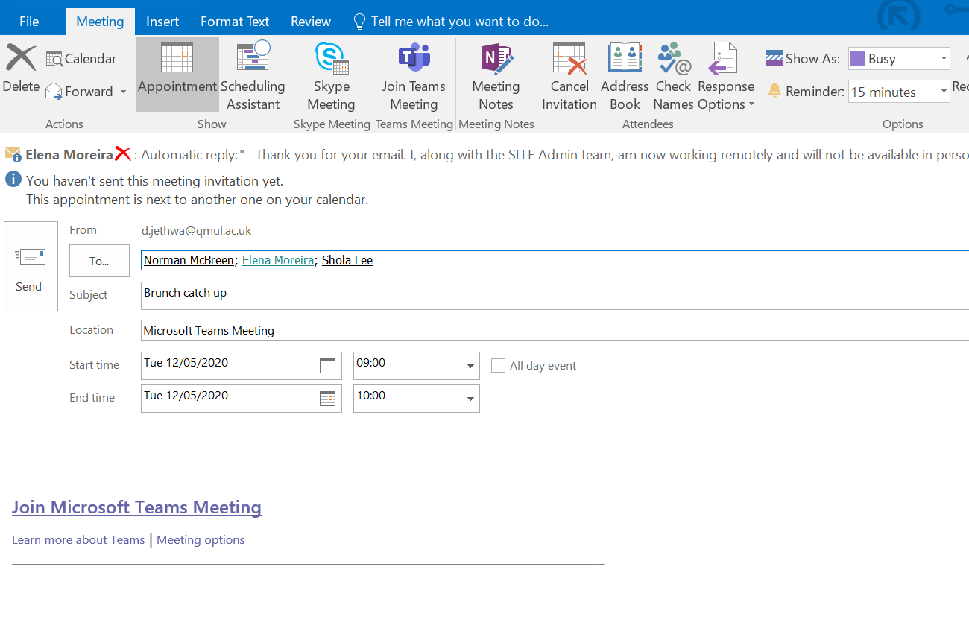
MS TEAMS
Setting up a meeting in MS Teams is as simple as adding a Teams Meeting to an invite
Notes:
Setting up a Teams meeting is pretty straightforward if you have not done this before…
Just go into your outlook calendar, and click on MS Teams, then invite the people you want to attend.

Slide 16
Short Film
Notes:
Now were going to watch a short 3 min video on empathy, then when you come back, we will have a quick discussion about it then we can have our 5 minute break.
Click on the link in the chat to video now: https://www.youtube.com/watch?v=1Evwgu369Jw

Slide 17
Empathy
Empathy is the ability to understand someone else’s feelings and emotions.
Some useful ways to communicate effectively and empathetically.
Ask open questions.
Withhold judgement.
Validate their emotions.
Treat your mentee as important.
Offer help
Notes:
Empathy is a core skill to be an effective Buddy.
So what is empathy?
For those of you who have had the chance to watch the video, what did you note were the key things about empathy?
As the video showed, being empathetic is about understanding someone else's point of view without judgement.
Open Questions - Asking the right kind of questions to make sure they feel comfortable to share information with you
Withhold judgement - Everyone has their own opinions, life experiences, lived experiences and ideas about things, so this is an important thing to remember when speaking to people. But when you are talking to your mentees, it is important that you try and put these to one side, without judging based on your on experiences
Validating peoples emotions – Understanding that its ok for people to be upset, angry or frustrated with things that might seem quite trivial or small to you, but understanding that this is their position on the situation, and respecting that, and encouraging them to open up.
Treat your mentee as important – Bearing in mind that we are probably going to be meeting people in the online world and that people wont of had the chance to get to know people amongst themselves like you might have of had the opportunity to. You may be the first person in QM to treat this person as important, so its important that the mentees feel like they have your full attention and that they are being heard.
Offer help – Another thing you can do is offer to help someone, but please only offer help within your capacity. You are not expected to be someone's counsellor. You are there to have a good conversation with someone and find them the appropriate support they might need.
Give them suggestions as to the options they have on how to deal with their problem. I’ll cover this more when we look at referral next but make sure these are just suggestions

Slide 18
5 Min
Comfort Break

Slide 19

1.
Your mentee failed their first piece of coursework and is distraught having always achieved highly before.
Notes:
Now I would like us as a group to think about how you might deal with this type of situation – what do you think you can do about this as a mentor?
Often our students can come uni with quite high expectations themselves, and think that they are all going to get Firsts in their degrees, but we know this isn’t the reality of the situation. It can be quite upsetting for people when they get their first marks, if they aren’t as high as the marks that they were getting before, when they may have been top of the class. Helping people to overcome that learning curve, and helping them to see the bigger picture can really help.
Its okay to do badly and make mistakes, because you can learn from it, and it’s a natural part of process. Have you had a similar experience yourself? Can you relate?
Encourage and empathise with them as much as you can, even if you don’t think it’s a massive deal, its important to remember it might be to them

Slide 20

2.
Your mentee tells you she thinks she might be pregnant.
Notes:
How do you think you might deal with this situation?
When someone's told you about a situation like this, firstly they have put a lot of trust in you and it might be difficult if this isn’t a situation that you understand, as it might be outside your sphere of experience. You might also think that this isn’t a good situation for her to be in. But it is important to remain out of judgement, and open to the fact that this is her experience.
Remember that someone has put a lot of trust and faith in you to tell you something like that.
Essentially its important to be present, sit and listen, and think about with them what/who might be able to help. We have lots of support services available to them at QM, that I will run through in more detail later

Slide 21

3.
Your mentee tells you they feel depressed.
Notes:
How might you deal with this situation?
Its quite common for people to use the term ‘depressed’ when they are feeling low or unhappy. So it might be worth just asking a few more questions, like has there been an incident or trigger? Speak to them 121, let them know that there are people who can help with this.
All of us at some point have felt low or unhappy, so try to empathise with them.
Arriving at university for the first time as you all probably know can come with great highs and lows. So taking the time just to talk to them and listen to them can be really valuable.
Hearing the term ‘depressed’ can be scary, but try not to be frightened as this term can often be used colloquially to describe someone experiencing low mood. Of course, if this is something that has been going on for some time, its important to let them know that there are specialised support services within QM that can help.

Slide 22

4.
Your mentee tells you they have a disability that they have not disclosed to the university.
Notes:
One more look at a case study. How might you deal with this type of situation?
Are there any particular disabilities you can think of that someone might not want to disclose to the university?
Mental health conditions – A lot of people might feel worried about disclosing this type of condition, in fear that they might be stigmatised and so don’t necessarily want to seek the support that’s open to them. But helping to signpost students in this case, to the support services available across QM could be really beneficial to them.
We have a team of 3 mental health co-ordinators at QM who sit with this DDS team who can help people in this type if situation
Dyslexia might be something that someone doesn’t want to disclose or they may have only been diagnosed with this at university, which is incredibly common these days. It's estimated up to 1 in every 10 people in the UK has some degree of dyslexia. In this case, you might want to speak to someone in the DDS team or consider speaking to their adviser or SSO
Many disabilities and long-term conditions are hidden, so it is possible you are supporting a mentee with a disability without knowing it. This could include a physical disability, sensory impairment, Specific Learning Difference (e.g. dyslexia, dyspraxia, ADHD), Autistic Spectrum Condition and/or mental health difficulties.
However, there are lots of things that we can all do to make university life more accessible and inclusive for everyone, for example:
- Give mentees as much notice as possible about dates/times for meeting, and if there is a change to this, let them know as soon as possible
- If meeting online, give them a choice about having their camera on or off
- Use clear, non-ambiguous language
- If sending emails, it can help to keep sentences short and key points listed in bullet points for easy access
- Be patient – some people may need some more time to think of a response to a question

Slide 23
Referral
You should refer when:
You are unable to be genuine, honest and impartial
You are worried that the person might come to harm or get into deeper problems
You are concerned that the problem is something that you are not equipped to deal with
You are concerned about your own circumstances
Unsure about referring someone? Email us at buddyscheme@qmul.ac.uk
Notes:
Now we’re going to think about some of the support services that are available to you at QM and when to refer people to these support services:
If you are worried about one of your mentees and you're not sure where to send them, please get in touch with us, and we will find the right person for them to speak to

Slide 24
Contacts
Advisor and Student Support
http://my.qmul.ac.uk/services-and-support/student-support-contacts/
Disability and Dyslexia Service
Assists students with any diagnosed physical or mental health issues
www.dds.qmul.ac.uk
Report and Support
For anyone who has experienced or witnessed sexual violence, bullying, harassment or hate crime
reportandsupport.qmul.ac.uk
Academic Support
Academic Skills Enhancement team – ASE
https://www.qmul.ac.uk/newstudents/becoming-a-queen-mary-student/academic-skills-enhancement-ase/
PASS
https://www.qmul.ac.uk/outreach/our-activities/pass/
Advice and Counselling
Confidential, professional support and advice for emotional, psychological, financial and student welfare issues.
www.welfare.qmul.ac.uk
Out of hours…try Togetherall
https://togetherall.com/en-gb/
Student Health Service
An on-campus, weekday NHS medical service for students living in QMUL halls of residence, or off-campus but within Tower Hamlets.
www.studenthealth.qmul.ac.uk
A detailed list of all the support services available at QMUL can be accessed here: A-Z Guide Student Support Services
If you have concerns e-mail: buddyscheme @qmul.ac.uk
Notes:
If you are concerned about your mentee you can advise that they seek support from many of the support services available within QMUL:
First port of call with a student with a pastoral or academic issue might be there Advisor or SSO:
- Every student has been allocated an academic who is their named adviser. You can ask if they have considered speaking to them about their issue. There isn’t much they haven't dealt with so could help. If you don’t know who this is, or are unsure about them, every School has an SSO, so if you click on this link there is a list of all the current SSO’s in every School and their contact details
DDS (Disability & Dyslexia):
Diagnosed or undiagnosed mental health differences, or people with particular learning differences like dyslexia and dyspraxia.
The DDS team can help put practical measures in place to help students manage studies alongside their condition
Report and Support tool:
This is an online system for anyone that has witnessed or experience, bullying, harassment or hate crimes. We have this tool available as it is important to us that if you have seen any of the above happening that it is brought to our attention so it can be dealt with. You can report either with your name or anonymously. The system is monitored by the Head of Wellbeing and Student Life daily.
The Learning Development Team aka Academic Skills Team are based in the library and can help students with:
Writing essays
Study guidance
Referencing
Constructing arguments
They offer study skills tutorials, Support with Academic writing and lots more. They are a great service to help students see where they are going wrong and help improve their marks so worth checking out
PASS (Peer Assisted Study Support)
This scheme at qmul has been running successfully at QM for the last 15 years, it is going to be running next year in the virtual world too
Advice and Counselling:
On top of the more obvious counselling service that they offer, they also provide a substantial financial and welfare advice service who can help with: UG/PG funding, Welfare & Disability Benefits, Debt Advice, Applying to external sources for funding, immigration advice and lots more.
Big White Wall - Big White Wall offers unlimited, 24/7 accessible online support – you can connect with peers, chat online to clinicians, use self-help resources, join groups or take self-assessments. Lots of students at lots of universities find it an incredibly helpful resource. It is also completely confidential and staff at the university cannot see what you are writing or sharing.
Student Health Service:
Located in Geography Square in the Mile End Campus
Typical GP service that office the standard physical, mental and sexual health services that you would expect
This is just a brief overview, but if you have any further questions please do get in touch

Slide 25
What to say?
It is important to make sure that when you are referring students to another service you are suggestive rather than prescriptive. You want to give them all the options and allow them to come to their own decision about how they want to move forward.
Use phrases like
You might find it helpful to…
You might like to talk to…
You might consider talking with…
Have you thought about…
Don’t say things like
You need to see…
You must talk…
You have to do…
You should…
Notes:
When you're referring somebody, they often don’t take it so well if you TELL them what they should do. People often respond better to things when they are suggestive rather than prescriptive

Slide 26
Your Responsibilities
CHECK on your mentees every week
BE ACCESSIBLE via email
BRIEF mentee on confidentiality
MAKE 4 opportunities to meet up over the year (physical or virtual)
COMPLETE your online reflection
Notes:
CHECK: This will probably be more frequent to begin with as they will still be getting used to the new environment and we expect this to tail off
BE ACCESSIBLE: Via email. This will be a good time to find out which communication method is best and whether they have specific needs, a student will usually tell you but we will discuss this in a little more depth shortly.
BRIEF: You must treat anything that is said to you in confidence – unless you feel that the person is at risk of harming themselves or others, in which case we ask you to contact me or another relevant service asap! If you are ever unsure please just get in contact the Buddy Scheme e-mail and we can advise you.
MAKE 4: Arrange 4 meet ups over the course of the year, either physical or virtual
COMPLETE: Online reflection – I will talk about this more on the next slide

Slide 27
What Online Reflection?
Don’t worry about this task – we are not judging your writing quality!
To include:
What you have learned from being a mentor
What you have enjoyed about the scheme
What could be improved for next year
What advice you would give to someone else considering being a mentor
A sample is available on the Buddy Scheme QMplus page
Notes:
We will not be judging you on the quality of your academic writing, you do not need to include references

Slide 28
Employability
As a Buddy Scheme Mentor, your completion of the programme can be recorded on your HEAR transcript so will be visible to future employers.
To complete the programme you will need to:
Complete this training session
Meet your mentees during Welcome Week
Arrange a further four face-to-face meetings with your mentees
Complete a 500-750 word reflective piece on your experience of being a Buddy Scheme Mentor
If you would like to know more about marketing your skills to future employers come to the Buddy Scheme Careers session, more details will be available nearer to the time.
Notes:
As a Mentor having completed the scheme, once you have submitted your online reflection your details will be sent to the QM Extras team so that it can be added onto your HEAR transcript.
If you want to think about how you can market the skills that you have gained through this process to future employers, we will organise a careers session for you, that will take place in semester B, between January – March.
Last year it was really successful and the mentors got a lot out of it

Slide 29
2022/23 Prizes and Events
 | Dates open
Instagram Buddy Scheme prize Upload photos of you and your buddies sharing an experience to your main Instagram or Instagram Stories #qmbuddyscheme. Prizes to win! | 19th September – 14th October
Careers advice – want to know how to market your experience to future employers? | A session will be organised in Semester B, more details to follow
Best Mentor | 1st March – 17th March
Best Reflection | 14th March
Notes:
There are going to be a number of prizes and event that you get involved in as we want you to get the most out of this experience and share your experience.
INSTA COMP – upload a picture with a caption, tagging #qmbuddyscheme to win prizes! This can be a nice nice breaker activity to do with your mentees too
CAREERS ADVICE: Just mentioned, a session will be organised for you in semester B, more details will be uploaded onto the QM plus page nearer to the time
BEST MENTOR: This is where we write to all of the mentees asking them to nominate their mentor for the Best Mentor competition. We look at all of the entries then pick the winner, who get a £50 amazon voucher
Best Reflection: You will also win £50 for the Best Reflection competition

Slide 30
Supporting Different
Groups of Students
Queen Mary is in the top 25 most diverse universities in the world in terms of international students uptake.
Having a hugely diverse community means that extra caution has to be taken when planning activities for your group.
It is important to make sure that the activities or events are entirely inclusive
Some students may also be vulnerable, try to ensure meetings are in public spaces
Inclusivity training is available on our
QMPlus site Buddy Scheme 2022/23
Notes:
Its important to bear in mind that we are a very diverse university, in terms of our international student uptake, we are hugely diverse which is one of our strengths at QM.
For this reason, it is important to ensure that the events you arrange are inclusive & accessible
Be culturally aware:
Think beyond race and ethnicity. A person’s culture is shaped by more than the colour of their skin or the way that they dress. It’s shaped by the person’s life experiences and traditions, which may be seen or unseen to the naked eye.
Learn by asking. Don’t be afraid to ask questions. People feel respected and appreciated when others take a genuine interest in who they are, so ask open-ended questions about their culture to learn more.
Exchange stories. Storytelling is a great way to share experiences that go beyond culture. Initiate an open conversation by sharing a personal story or experience.

Slide 31
Mentees and Meetings
1
Introduce Yourself
2
Ask them to introduce themselves
Hi!
3
Icebreaker
4
Find out why they signed up to the scheme
5
Explain what your role is
6
Decide on your next meeting
Notes:
Your first meeting with your mentees should be about getting to know them and for them to get to know each other.
Introduce yourself – your name, your course, your year and any other info that you think might be necessary. Ideally, they would have already received an email from you before their arrival, but it won’t hurt to re-introduce yourself, as this is your first face-to-face meeting. State that you will be their mentor for the next 7 weeks.
Ask them to introduce themselves – it’s only natural that you ask them to tell you their names and a little bit about them. This will help you establish a connection and hopefully make you less nervous.
Icebreaker – we will provide an icebreaker activity for you.
Find out why they signed up for the scheme – it is essential that you know what their expectations are so that you can offer targeted support. Ask if they have any questions at this point. Recommend that they go to the Welcome Fair and make specific suggestions (if you think they should join Society X, or sign up for a sport).
Explain what your role entails – During the next few weeks, I will be here to give you tips and help you have the best experience as a fresher. You could also tell why you wanted to become a mentor on the Scheme
Decide on your next meeting – find a time and place that is suitable for everyone. Send everyone an event invitation on Outlook and send an email reminder 48h before. Always meet on campus or in venues very close to campus, that are frequented by other people (Starbucks, Costa). Make note of any accessibility needs that your mentees might have.

Slide 32
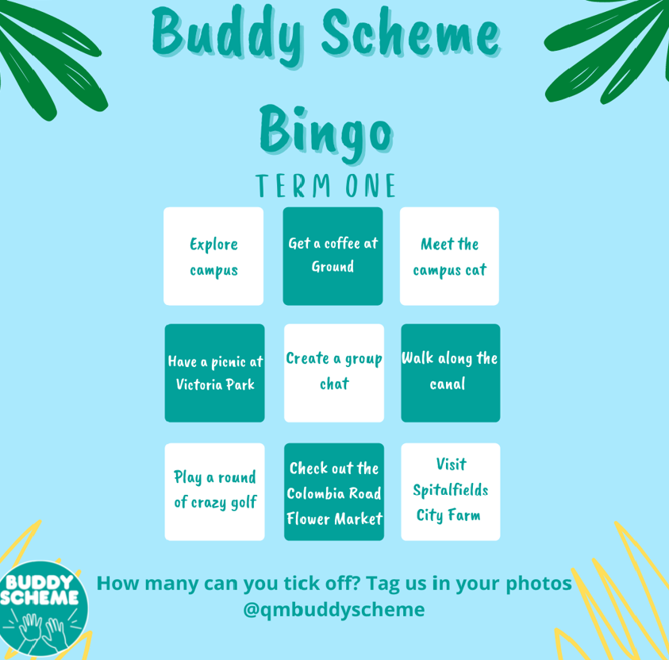
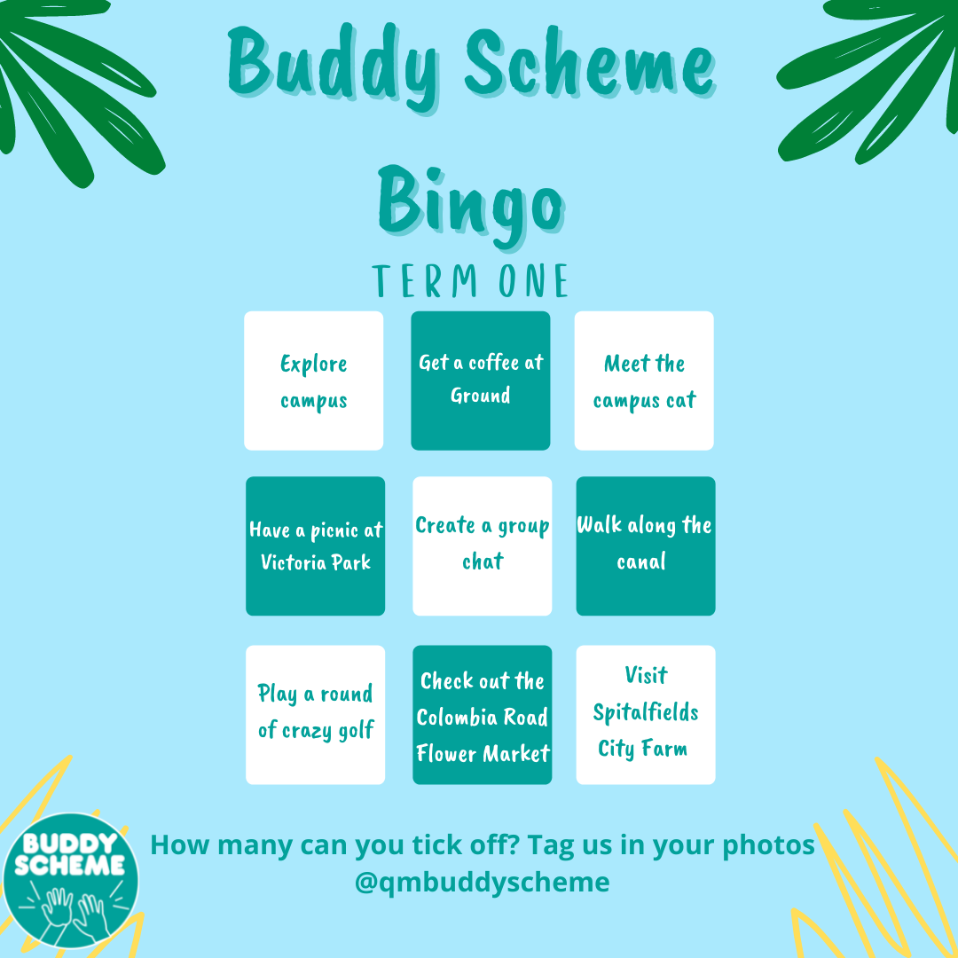
In-Person Activities
Take part in Buddy Scheme Bingo by ticking off as many activities as you can and sharing your photos with us, can you get a full house?!
Term One is all about getting to know your group and exploring the local area with fun, budget-friendly things to do!

Slide 33
In-Person Activities
Activities and meeting ideas:
Have a campus tour
Visit an East London gallery
Book a walking tour of London Graffiti
Show your mentees around the Welcome Fair
Pop round to Spitalfields Market
Have a coffee crawl
Go to Genesis Cinema
Visit a food market
Have a picnic in Victoria Park
Notes:
Here are a range of activities that you might like to do in person with your mentees, that are inclusive, cheap or free: Obviously please feel free to think up your own ideas too!

Slide 34
Conversation Topics
When planning your first meeting, take into consideration the following topics:
Best societies to get involved in
Best sports clubs and activities
Volunteering opportunities
Cooking ideas
Money saving tips
How to use library resources
Things to do in the area
Study methods
How to deal with assignment stress
How to get a part time job
Best places to eat on campus
How to take notes
Notes:
These types of topics can be really useful to mentees, and things that they would benefit from hearing a little more about

Slide 35
Icebreakers
Rose Rose Thorn Bud
Describe 2 things going well, one thing not so well and one thing you are excited about
How can we help?
Ask your mentees what they want to get out of Buddy scheme. What help are they looking for?
Two of a kind
Set a time limit and instruct mentees to find two other students they share something in common with. The idea is to help them make connections that may not be immediately apparent.
What is on your bucket list?
What is the thing you have always wanted to do?
Where am I from? Share a picture of your favourite spot in your local area
What meal would you prepare for all of us in the real world?
Notes:
In the virtual world it might be helpful to think of some virtual ice breakers:

Slide 36
Online Catch-Up Ideas
What can you do in the virtual world?
Have an online tea break/ pizza night
Scavenger Hunt
Have a cook off
https://www.bbcgoodfood.com/recipes/collection/student
Share your breakfasts
Play an online board game
http://playingcards.io/
Set up an online book club
https://www.penguin.co.uk/articles/2020/april/online-book-club-set-up.html
Movie night over teams
Host a quiz
https://kahoot.com/
Attend an online talk
https://www.ted.com/
Notes:
In terms of hosting an event in the online world, you could:

Slide 37
Next steps?
Get in contact with other mentors in your school and say hello (mentors lists per school will be put on the QMplus page following training in August)
Do the catch up quiz online (early September)
Student transition (from 19th September – 5th October onwards, get your group of mentees, email mentees individually, then arrange to meet up and meet each other)
Keep in touch with mentees throughout the year on a weekly basis online
Run at least 4 catch up events
Complete your write up for 14th March 2023 and upload to the
QMplus page

Slide 38
Any questions at any point
Please e-mail: buddyscheme@qmul.ac.uk
Give us your feedback! Only takes 2mins!!
Notes:
MENTIMETER – please take 2 mins to give us some feedback on this session
https://www.menti.com/ad9j3qny3n

Slide 39

Thank you!

